Slide 1
Artificial Intelligence Methods (AE2AIM)
Lec. 01-Part 1: Course Introduction
Dr. Xinan Chen (Room IAMET308)
School of Computer Science
The University of Nottingham Ningbo, China
Email: xinan.chen@nottingham.edu.cn
Web: research.Nottingham.edu.cn/en/persons/xinan-chen

Slide 2

Quick Survey (Anonymous)
What AI methods have you ever heard, learned or practiced?
Name two most significant AI applications in sports.
What are the things that you want to get from this module?
Please scan QR code and submit your feedback

Slide 3
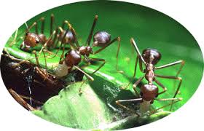
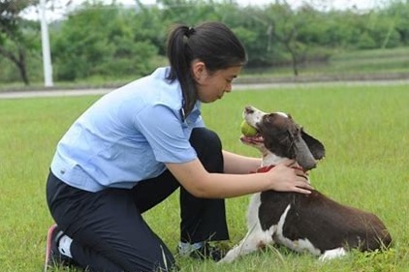
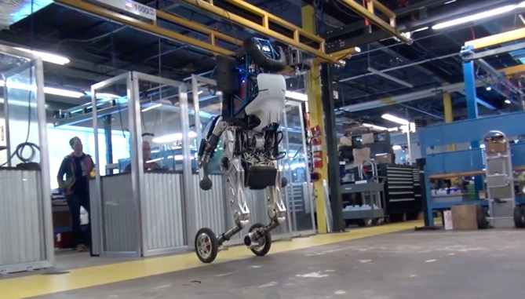
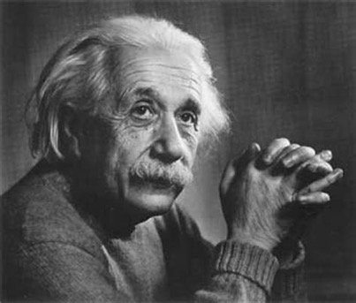


What is Intelligence?

Slide 4
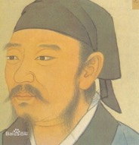
What is Intelligence （智能）?
“知有所合，谓之智；能有所合，谓之能”
- 《荀子•正名》
”the ability to learn or understand or to deal with or trying new situations”. – Webster
“capacity for learning, reasoning, understanding, and similar forms of mental activity; aptitude in grasping truths, relationships, facts, meanings, etc.” – Dictionary.com
Xun Zi (325BC-238BC)

Slide 5
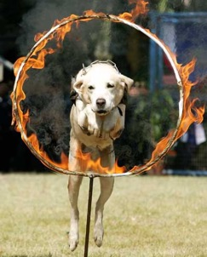
What is Artificial Intelligence?
Artificial Intelligence vs. natural intelligence
The term was firstly coined by John McCarthy in 1956,
Originally, means artificially designed agents that behave intelligently like a human being does.
AI in early days focuses more on reasoning, knowledge, planning, NLP, perception, etc.
John McCarthy (1927-2011)
action/decision
Environment
Goal(s)
reward
state/new problem
Notes:
Behave: reasoning, decision making, acting, percepting

Slide 6
Strong AI vs. Weak AI
Strong AI
AI capabilities (problems solving and reasoning) at a same level of human being
Has human like mind, consciousness, and self-consciousness
Weak AI
Capability to solve challenging (new) problems of a particular field
Mostly a simulation of real intelligence
Does not have consciousness or self-consciousness

Slide 7
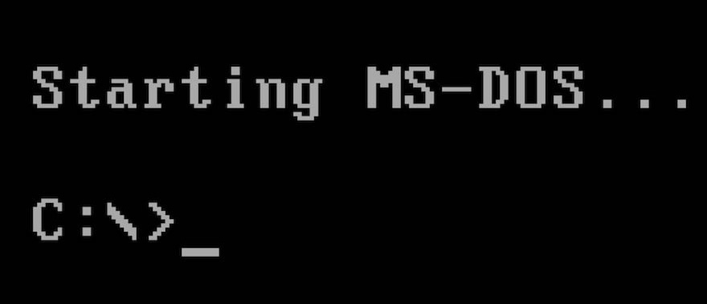

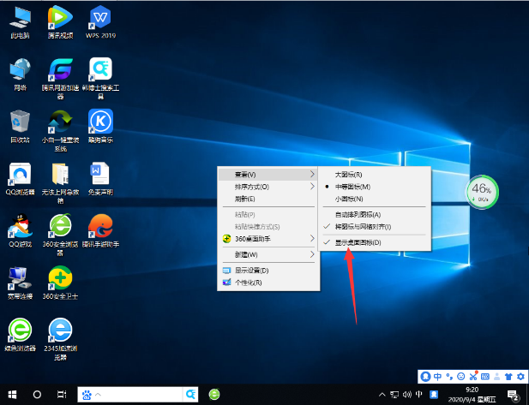


A New Era
视窗时代
Windows
触屏时代
Touch Screen
自然语言&AGI时代
Artificial General AI

Slide 8
Applications

Slide 9
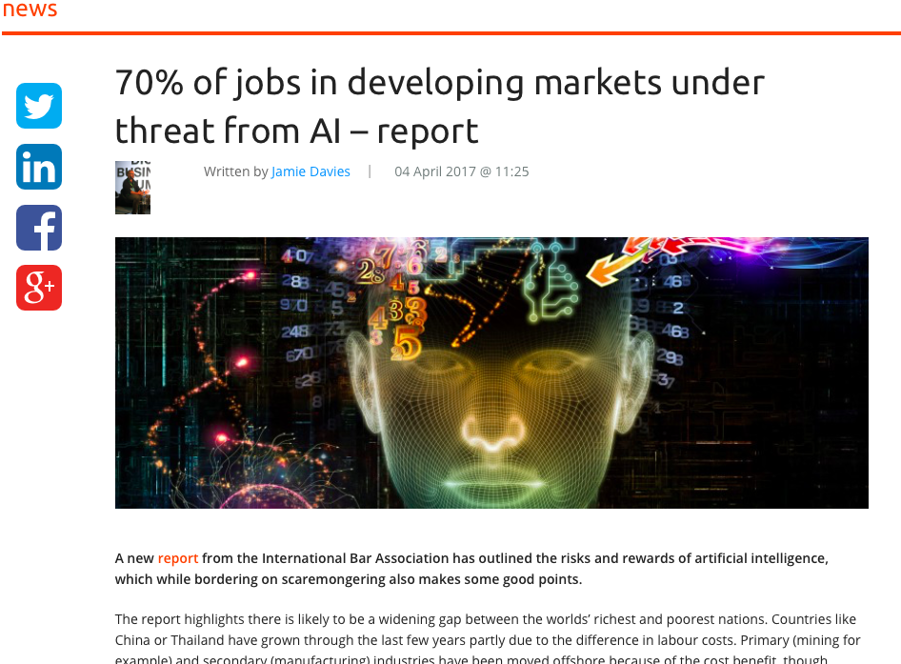
Flip Side of AI
Some jobs will be replaced
Truck driver, Accountant
Some jobs will be transformed
Catering services, teacher, designer, scientist, artist
Some jobs are still safe
CEO, Psychologist, Home carers

Slide 10
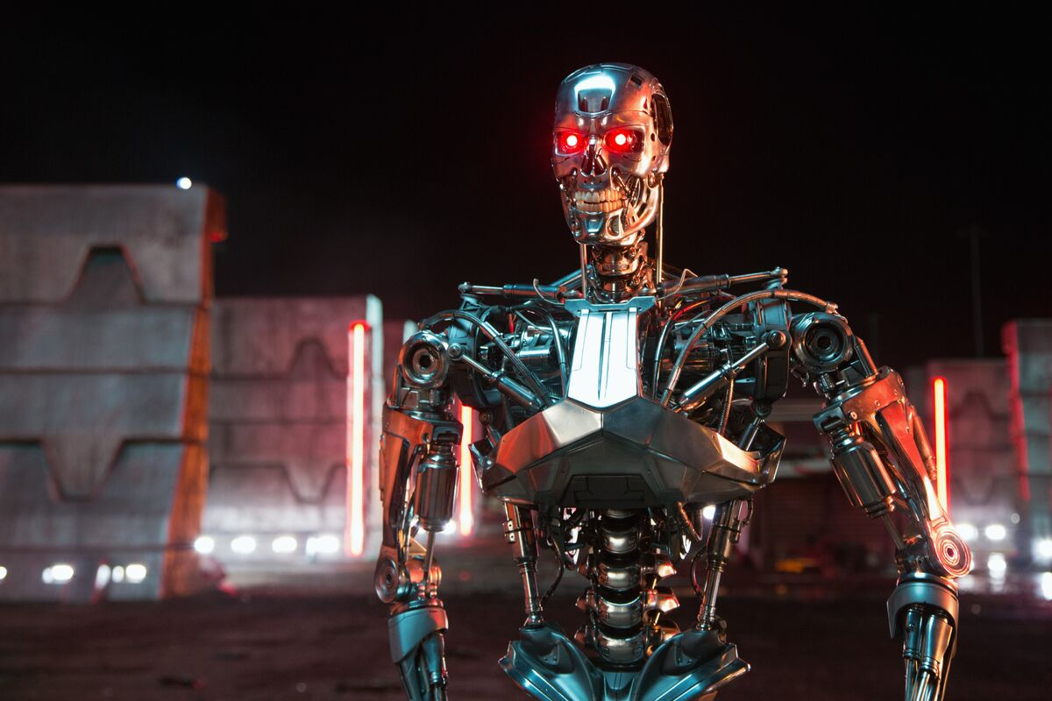
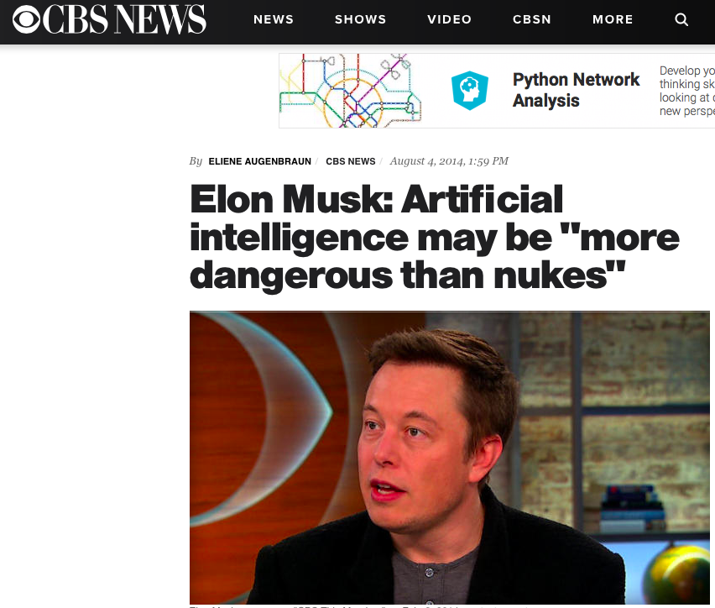
Flip Side of AI

Slide 11
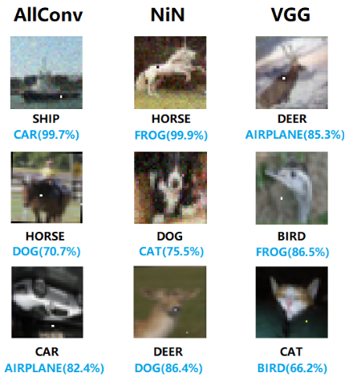
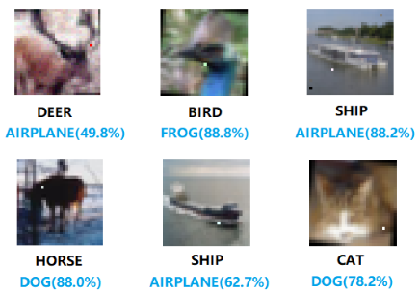
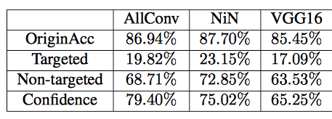
Security Issues: One Pixel Attack
Jiawei Su, Danilo Vasconcellos Vargas, Kouichi Sakurai. 2019. One pixel attack for fooling deep neural networks. URL: https://arxiv.org/pdf/1710.08864.pdf

Slide 12
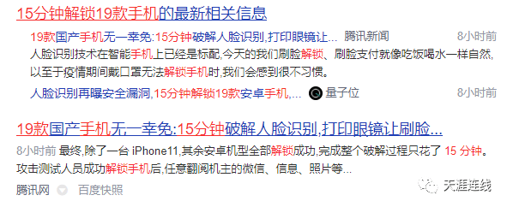

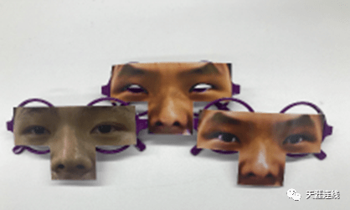
Security Issues: Face Recognition
Notes:
Calling for alternative AI methods to data driven AI methods.

Slide 13
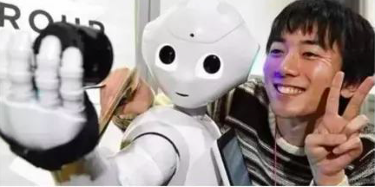

Flip Side of AI
Would you fall in love with a machine?

Slide 14
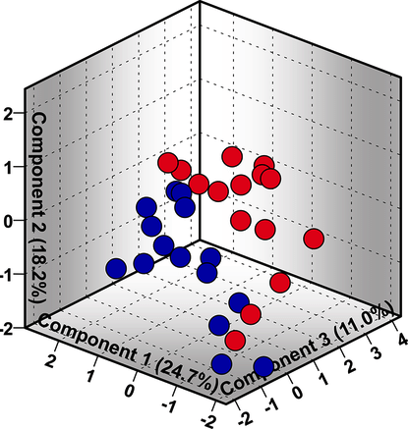

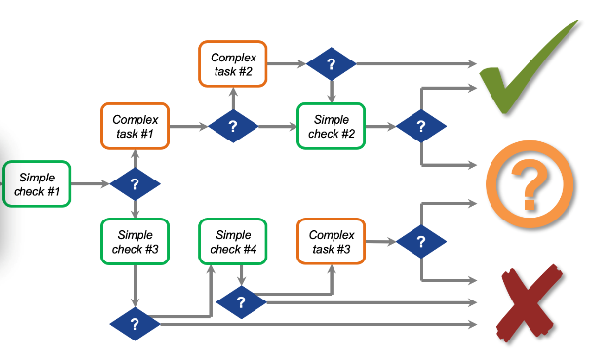
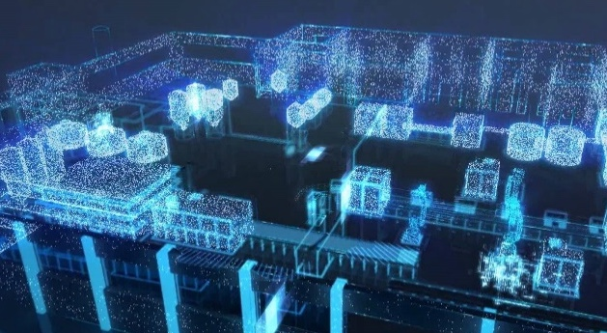
Stages of Intelligence
Digitalize Objects
Automate Processes
Optimize Decisions

Slide 15
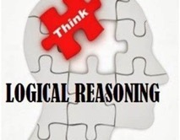
Categories of AI
Symbolic Intelligence
Graph Search
Automated Reasoning
Symbolic Learning
Knowledge Engineering
Computational Intelligence
Evolutionary Computation
Swarm Intelligence
Artificial Immune System
Neural Computing
Machine Learning
Generalisation Learning
Pattern Recognition
Statistical Learning
Reinforcement Learning
Deep Learning
Machine Perception
Computer Vision
Audio Processing and Recognition
NLP
Image Processing

Slide 16
What is this module about?

Slide 17

About This Module
Teaching Team:
Lecturers: Xinan Chen, Huan Jin
GTAs: Chenwei Jin, Lshan Tan
Module Activities:
2 hours lecture x 11 weeks
2 hours lab sessions * 10 weeks
Assessment
Lab quiz - (5%)
Coursework1 – (45%)
A 2-hour written exam (50%)
Office hour:
Refer to Moodle page
Discussions/Feedback
Moodle forum
Wechat group - Scan this QR code →

Slide 18
Provisional Topics
Week 1: Introduction & Basics
Week 2: Combinatorial Optimisation Problems and Modelling
Week 3: Heuristics and Hill Climbing
Week 4-5: Metaheuristics
Week 6: Linear Programming （Dr. Huan Jin）
Week 7-8: Evolutionary Computation
Week 9-10: Hyper-heuristics & /multi-objective optimisation
Week 11: Planning and Search / Revision

Slide 19
Reference books
Book 1: Metaheuristics: From design to implementation. EI-Ghazali Talbi, Wiley. New Jersey, 2009. Textbook. More resources at http://paradiseo.gforge.inria.fr.
Book 2: Tabu search / Fred Glover, Manuel Laguna. Fred Glover; Manuel Laguna. Boston : Kluwer Academic Publishers c1997. Available at Main Library Room 402 (T57.6.G5)
Book 3: Search methodologies : introductory tutorials in optimization and decision support techniques / Edmund K. Burke, Graham Kendall, New York : Springer 2014. Available at Main Library Room 402.

Slide 20
Why This Module?
Advanced optimisation algorithms
Providing solid foundation for better understanding/implementation of other AI and data analytical methods
Wide range of real-world applications
Build your own cyber girl/boyfriend
Other…

Slide 21
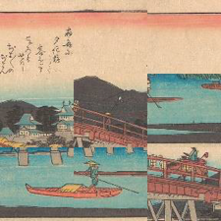
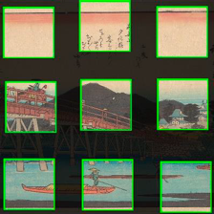

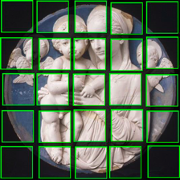

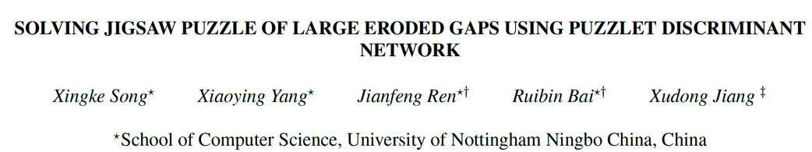
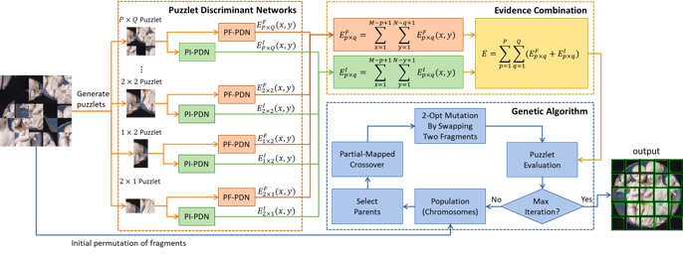
Jigsaw Puzzles Problems

Slide 22

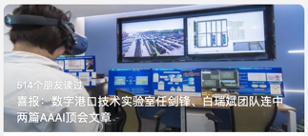
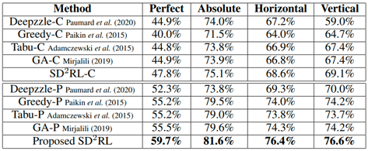
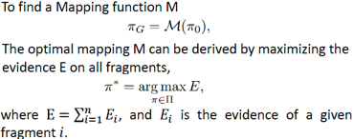
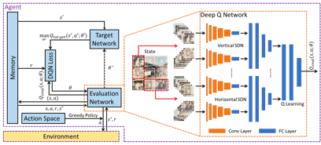
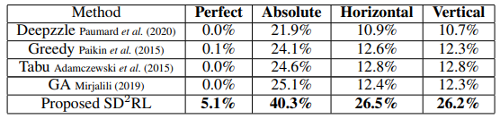
Popular Research Topics
Main Method: Reformulation as a combinatorial Optimisation Problem (COP)
Table1: Result on the JPwLEG-3Dataset
Table2: Result on the JPwLEG-5Dataset

Slide 23

Data and AI in Formula 1
Data mining in Formula 1
Every F1 car has 240+ sensors, gathering info for petrol, tire, balance, etc.
250+TB data/stop(bigger than total data in the US Congress Library)
Advanced data analytics and simulation tools

Slide 24
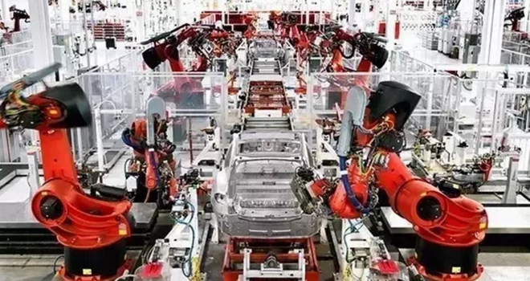
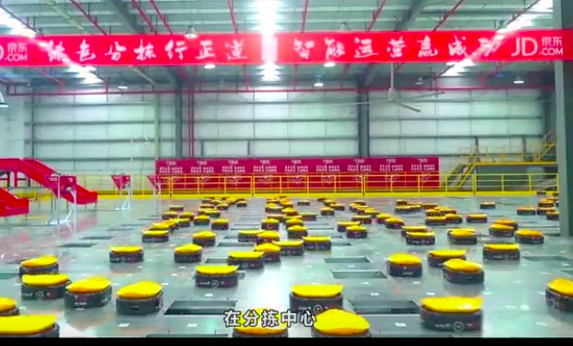
Routing and Scheduling
Tesla Automated Factory
JD.com Smart Warehouse

Slide 25
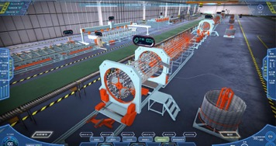

Smart Manufacturing: Production Scheduling
Digital Twin Factory
Production Schedule - 1
Tables
Bookcases
Wood
Labour
£25 profit
20 m of wood
5 hours to complete
£30 profit
30 m of wood
4 hours to complete
690 m/week
120 hours/week
Contract
How many tables and bookcases should the carpenter produce to maximise profits?
Express this question in terms of the optimisation framework in the previous slides (e.g. objective functions and constraints)
4 tables/week
2 bookcases/week

Slide 26
Production Schedule - 2
Maximise
Subject to
5 minutes
where x₁ refers to the number of tables and x₂ refers to the number of bookcases

Slide 27

Production Schedule - 3
Maximise
Subject to
where x₁ refers to the number of tables and x₂ refers to the number of bookcases

Slide 28
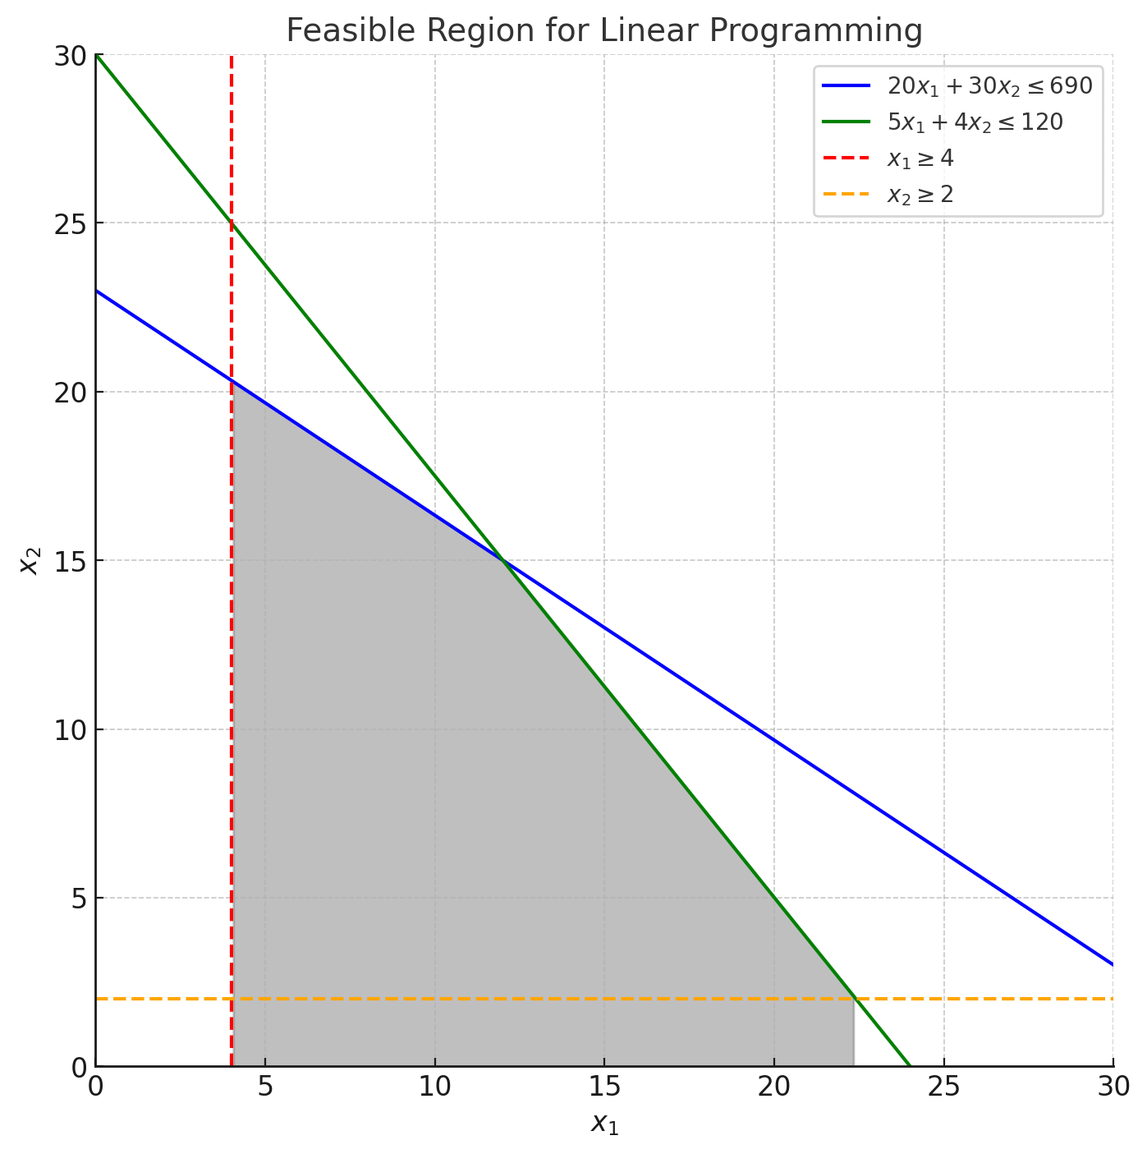
Production Schedule - 3

Slide 29
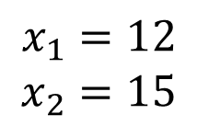
Production Schedule - 3
$$x_{1}=12$$
$$x_{2}=15$$

Slide 30
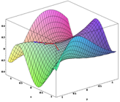
Numeric Optimisation
Various numerical methods exist to find (approximate) optimal solutions to non-linear optimisation problems
gradient descent (hill climbing)
Newton-Raphson
A unimodal function on an interval has exactly one point where a maximum or minimum occurs
if the function is multi-modal, it can be divided into several separate unimodal functions to use these methods
f(x)
f(x)
Unimodal
Multimodal
a
b
a
b

Slide 31
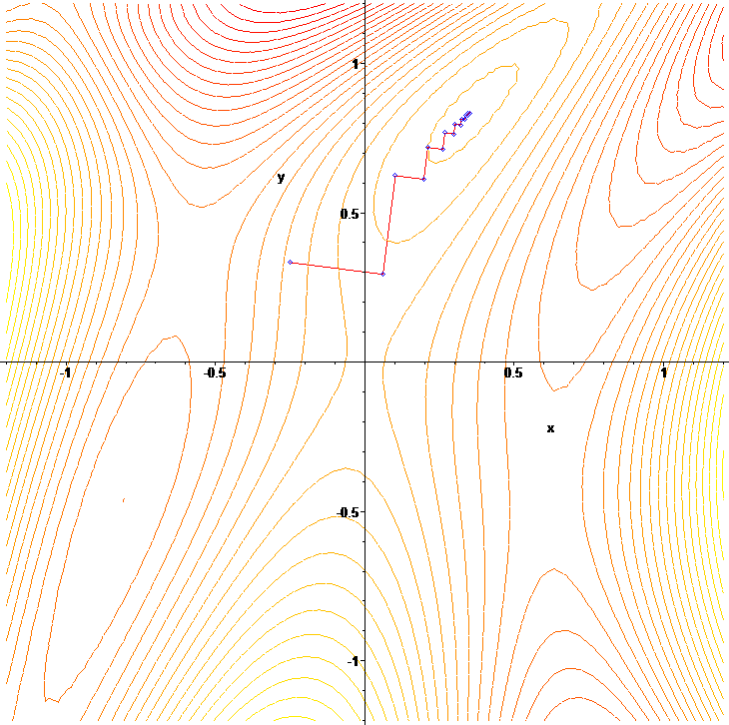
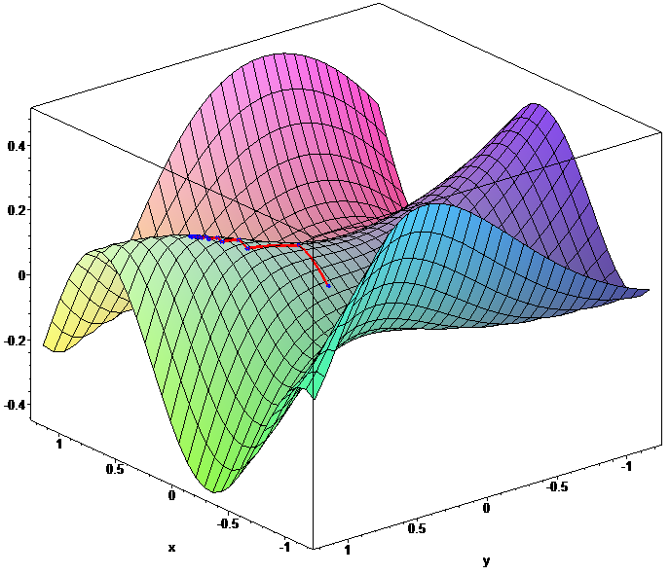
Numeric Optimisation
Gradient Descent (Ascent)

Slide 32
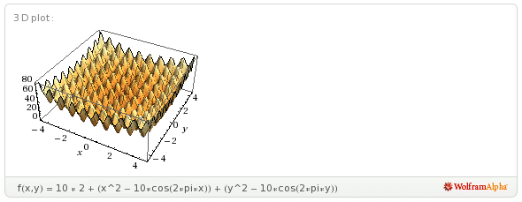
Numeric Optimisation Limitations and Difficulties
Many of these numerical methods apply to continuous functions with specific properties
continuous
differentiable
unimodal
In many real-world instances we start with little / no knowledge of the explicit functional form
even expert mathematicians cannot differentiate!
Further class of problems that are discrete / combinatorial

Slide 33
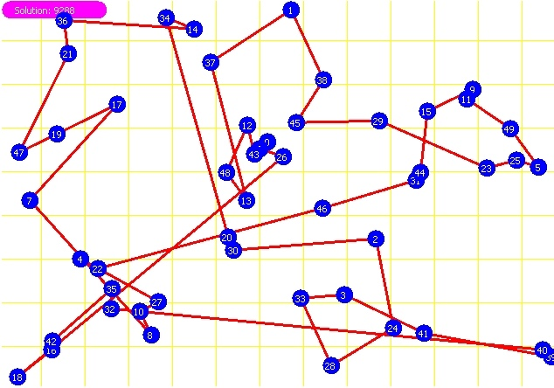
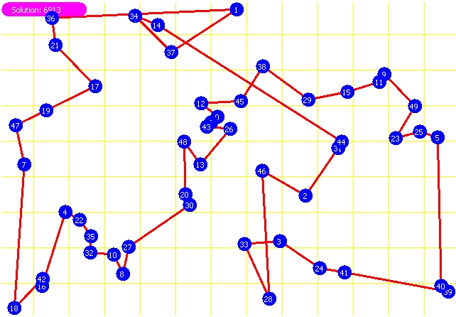
Example: Travelling Salesman Problem (TSP)
Consider a certain number of cities randomly spaced out
Objective: to find the shortest closed path that goes through all the cities without repeating a visit to a city
the solution is an ordering of cities

Slide 34

Combinatorial Optimisation Problems and Advanced Optimisation Methods
Problems
VRP
Timetabling
Scheduling
Challenges
Large scale
NP-Hard
Constraints
MOO
Non-linear
Uncertainty
Drawbacks of the current methods
Data
OR, CI
DNN
$$∑$$
Neglect uncertainty of data source
Model not flexible
computation time
Robustness
Poor Interpretability
Poor reusability
Low data efficiency

Slide 35
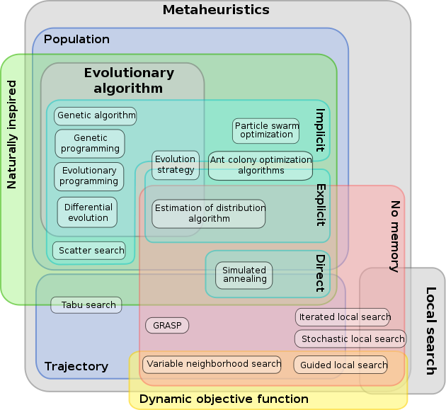
Optimisation Approaches - Metaheuristics Family

